Slide 1
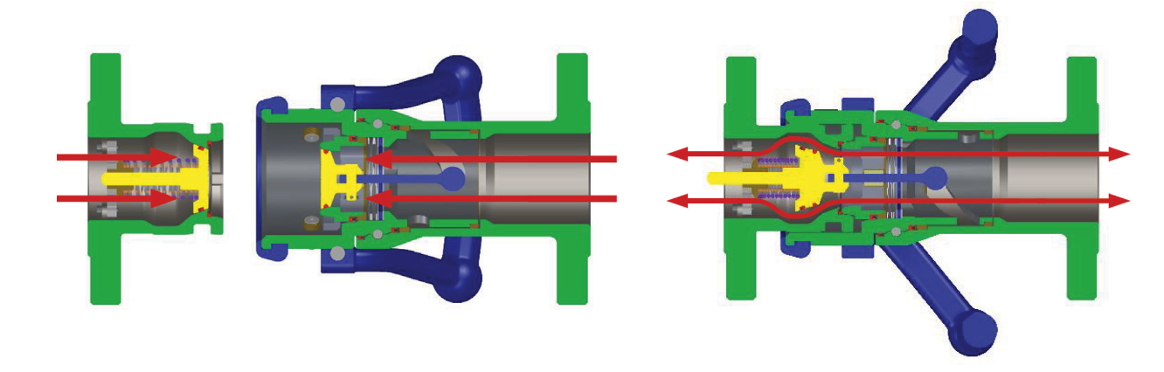
MannTek Coupling
AR Module
By Shashank Varshney
Project Development and Demo
https://github.com/shashank4412/MannTek-Test

Slide 2
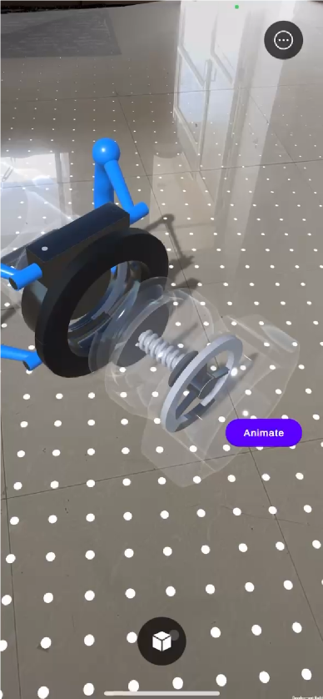
Introduction
This presentation outlines the development process and challenges faced while creating the Manifold Coupling AR Training Module.
It covers the project objectives and methodologies used to enhance user interaction and learning through augmented reality (AR) technology.

Slide 3
System Development Process

Slide 4






Project Initialization and Setup
The project involved Unity 6.2 (6000.2.1f1) with URP and AR Foundation.
In Unity we used Input System, Prefabs, Materials and Shaders and C# for animations.
We used Git with Github Repository for source control
This foundational setup ensured the project adaptation to most AR platforms,
It works on both IOS & Android, enhancing compatibility across devices

Slide 5
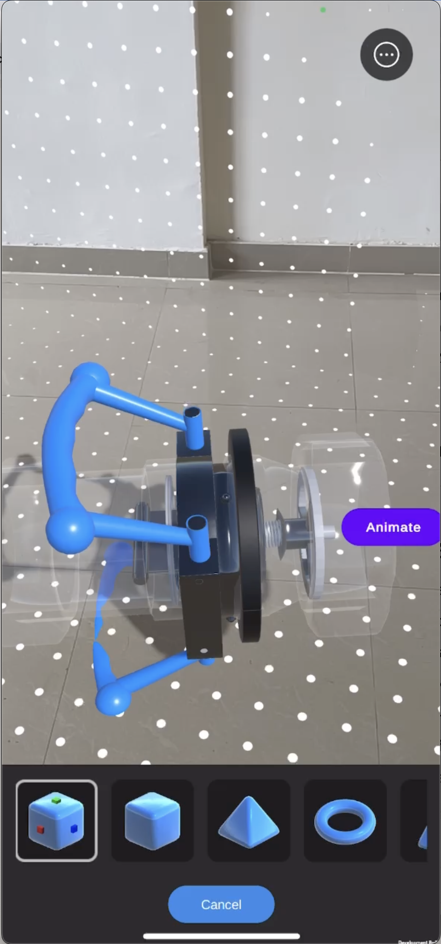
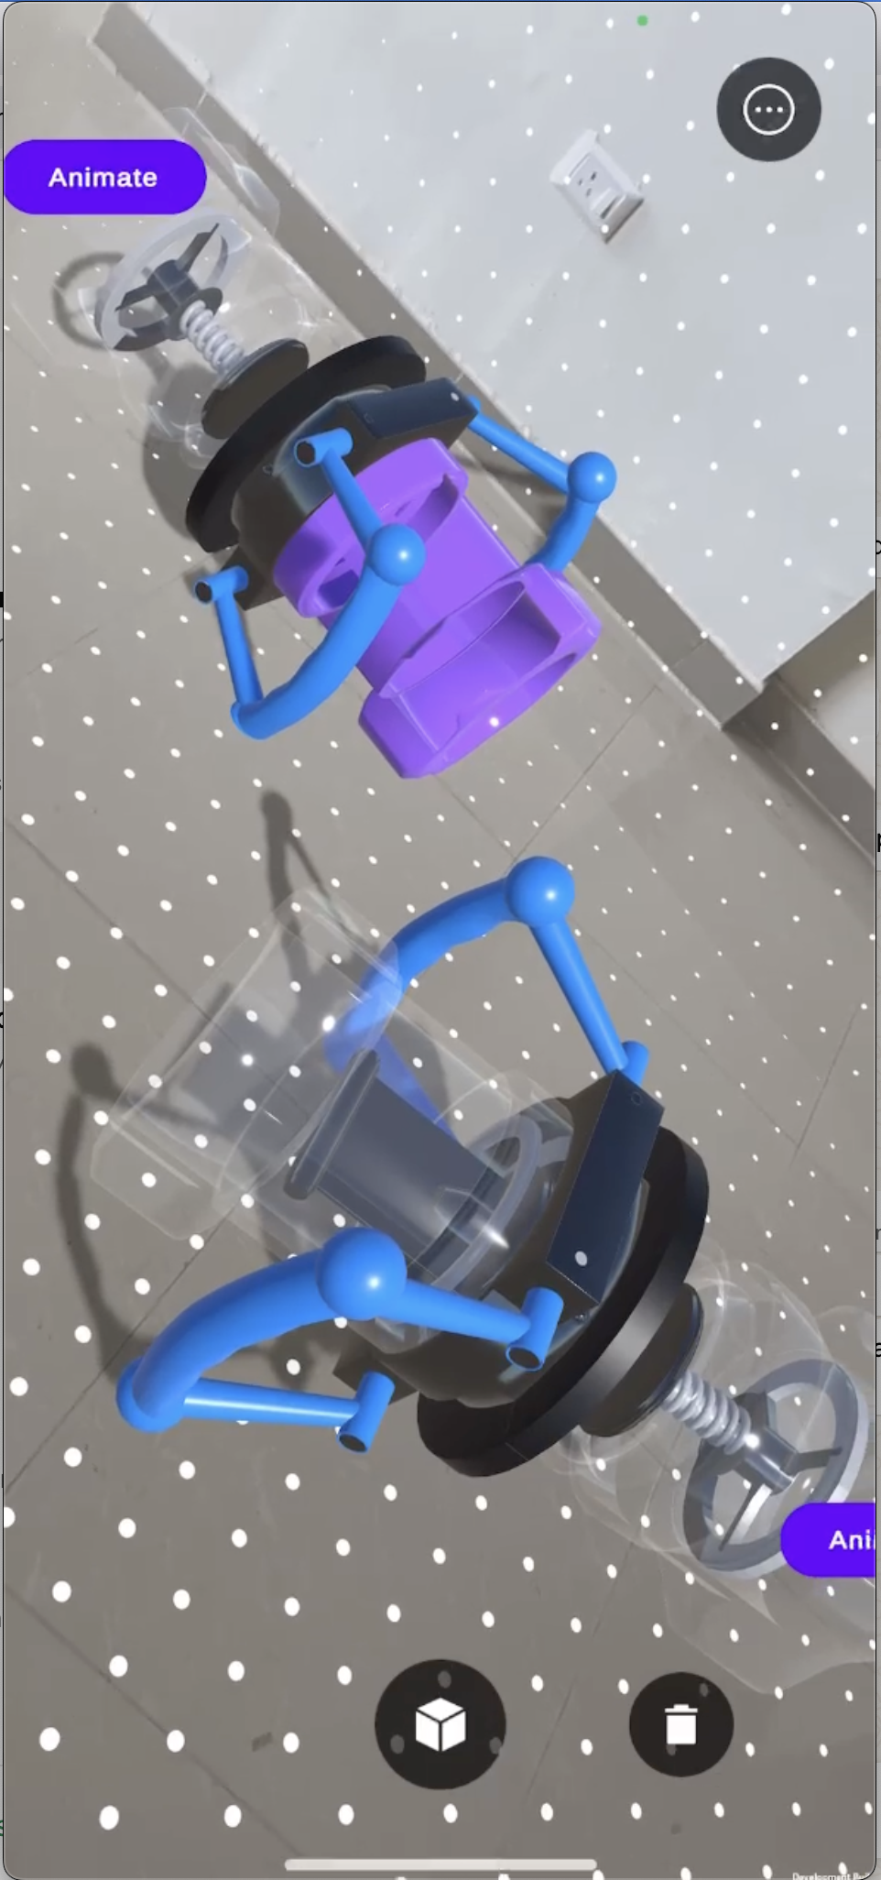
Challenges we faced
Throughout development, several challenges emerged, such as:
Imported model arrived as one fused mesh, requiring manual separation
Incorrect pivot points forced wrap-objects and transform adjustments
No prebuilt animations — had to code all movements, rotations and flow effects
Static ‘Animate’ button overlapping by game-objects and not facing the screen.
Ensuring AR tracking remained stable in varied lighting conditions
Balancing visual fidelity and performance on mid-range mobile devices
Coordinating UI arrows in world-space without occlusion issues

Slide 6
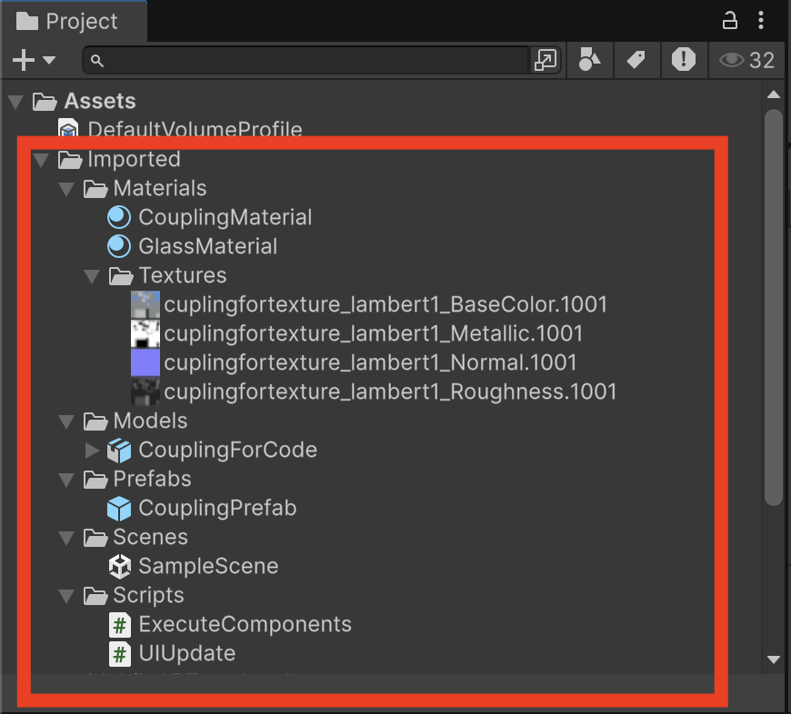
What’s New we Learned
Split a single FBX into modular GameObjects in Unity
Pivot re-anchoring techniques for precise rotations
Implementing AR Foundation placement and anchoring workflows
‘Animate’ button now facing the screen & never hinder by any object.
Mapping touch and gesture input using the Unity Input System
Performance profiling and mobile optimization strategies
Development Move, Scale, Rotate Features and visual tutorial
Compatibility for multiple model instances
Model Selection gallery and controller UI

Slide 7
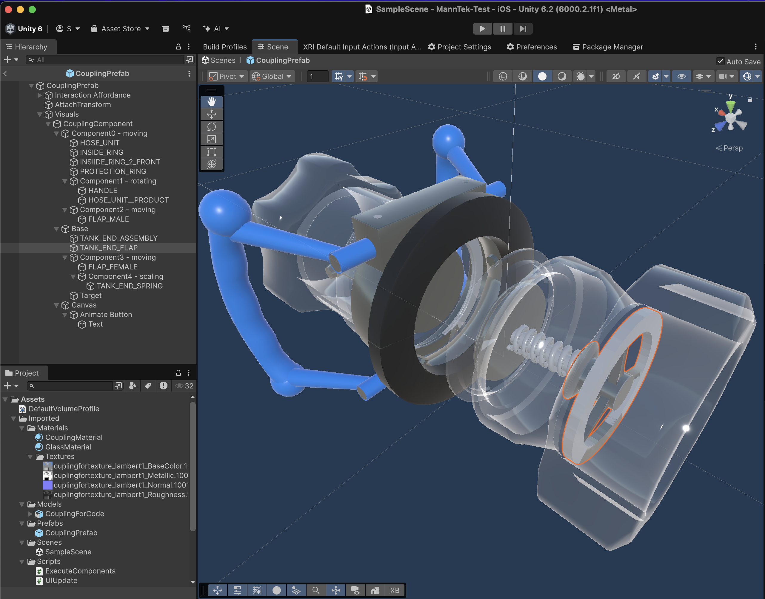
How we created
Project Initialization: Unity URP and AR Foundation, ARCore/ARKit. Configured Input System, Prefab variants & Git with github repository.
Asset Preparation: Split the single FBX, Set up colliders, LOD groups, and compressed textures.
Animation Authoring: Code handle-lock and unlock sequences, created cutaway flow animations with placement on detected surfaces.
Interaction Scripting: Created placement script using ARRaycastManager and ARAnchorManager for drag-and-snap logic with proximity checks and Unity Physics Ray-hit.
UI & Feedback: Programmed ‘Animate’ button to animate the model without any animation mismatch. On multiple instances.
Testing & Optimization: Build for Android & iOS devices. Profiling draw calls, GC spikes, and minimal material variants.

Slide 8
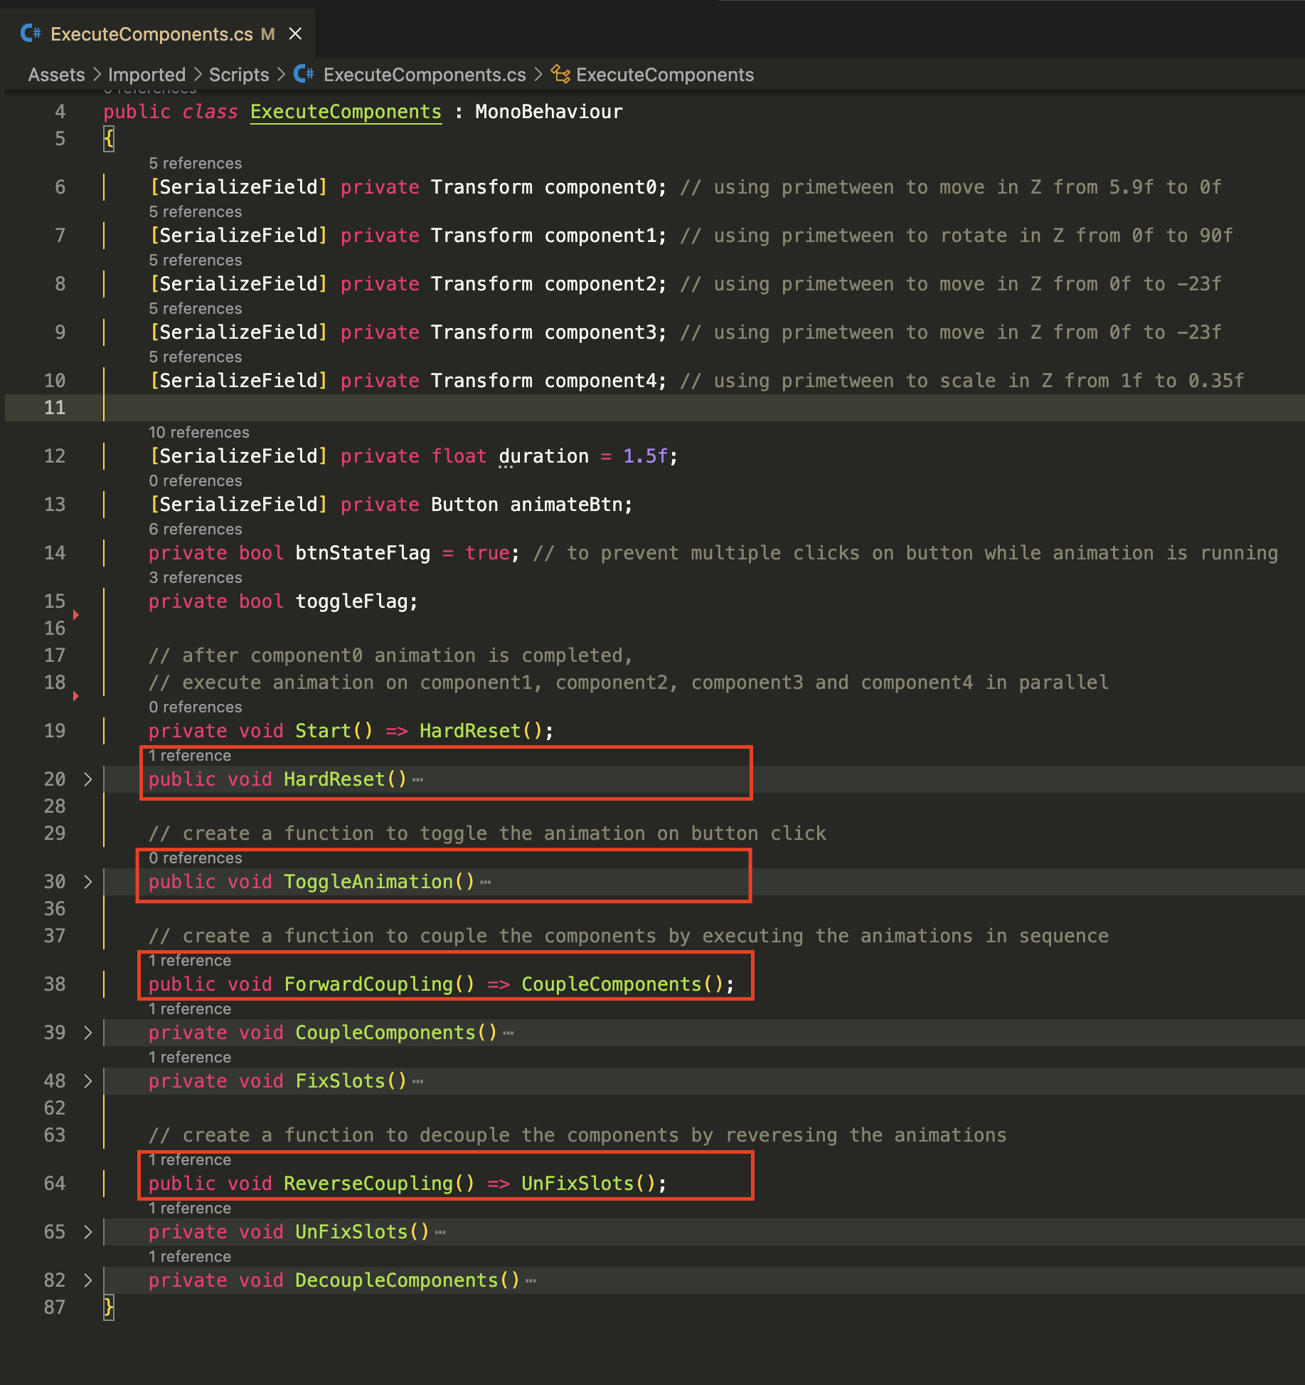
Conclusions
In summary, the Manifold Coupling AR Module successfully integrates innovative AR technologies with Modern learning methods.
Future enhancements aim to incorporate haptic feedback and more advanced analytics, further enriching the user experience and driving additional learning outcomes.

Slide 9
Thank you!
Developed by Shashank Varshney
shashankvarshney4412@gmail.com
+91 798 257 6794
Do you have any questions?

